Slide 1
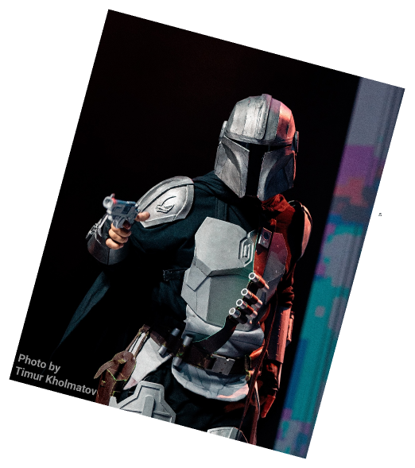
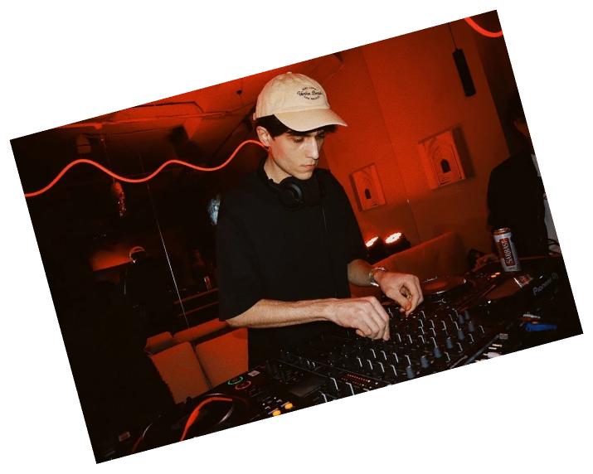
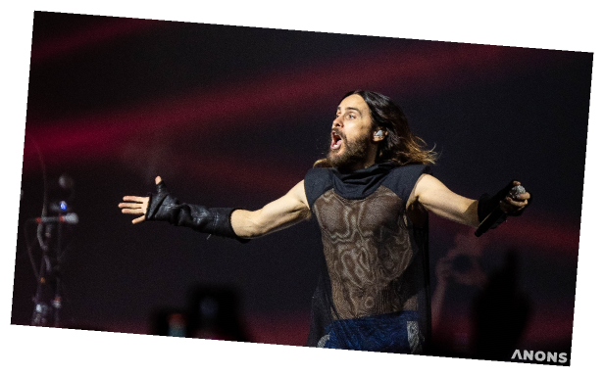
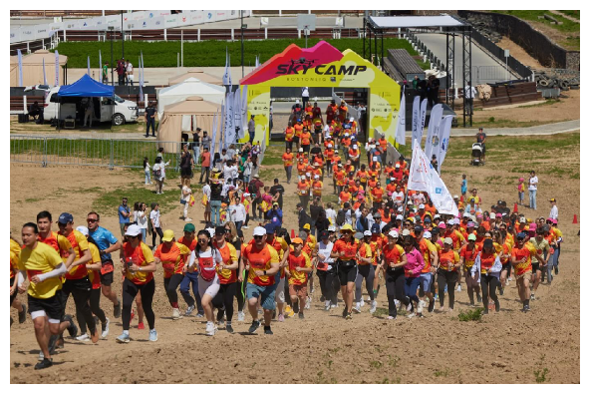


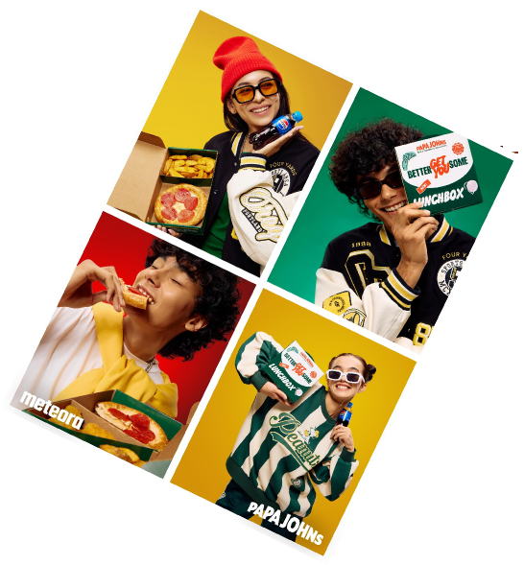
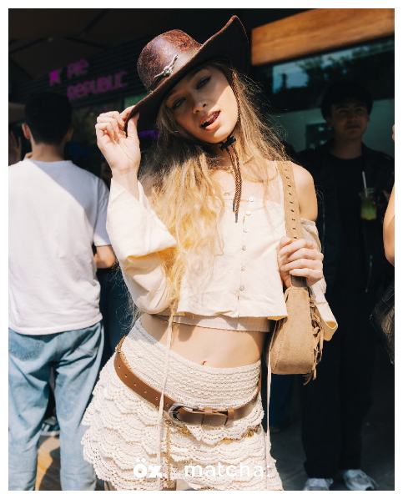
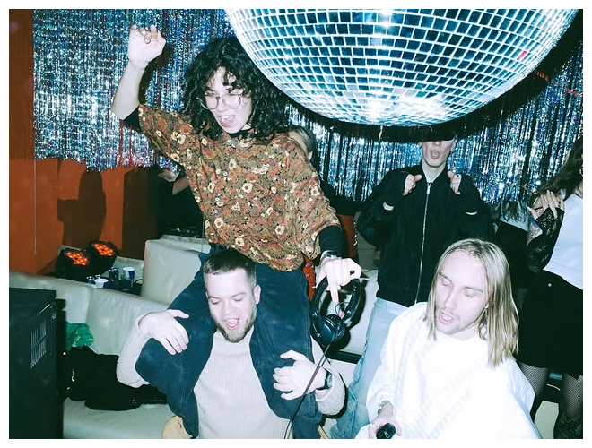

Notes:
Ташкент развивается, становится больше интересный мероприятий, фестивалей,...

Slide 2
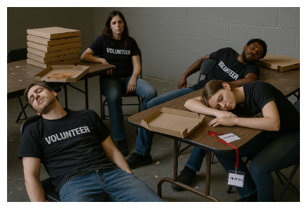
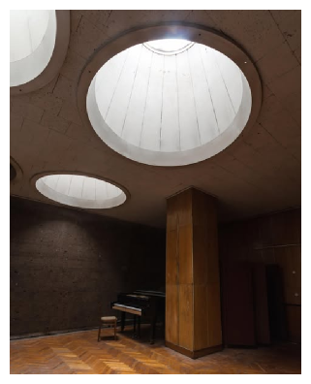
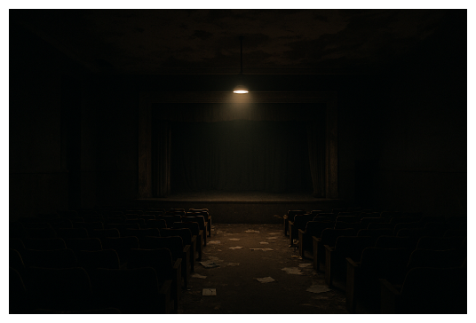
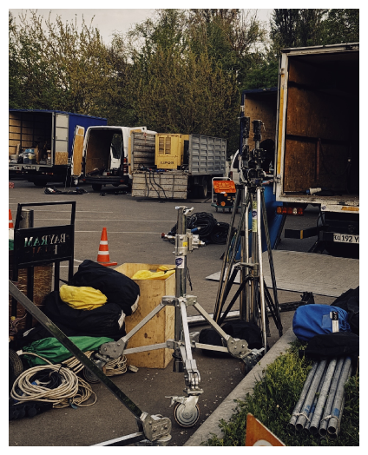
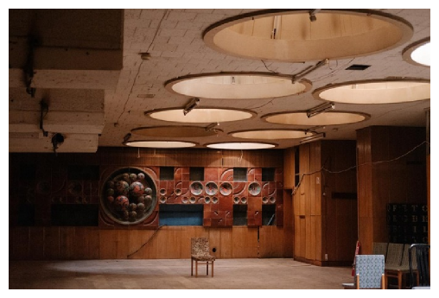
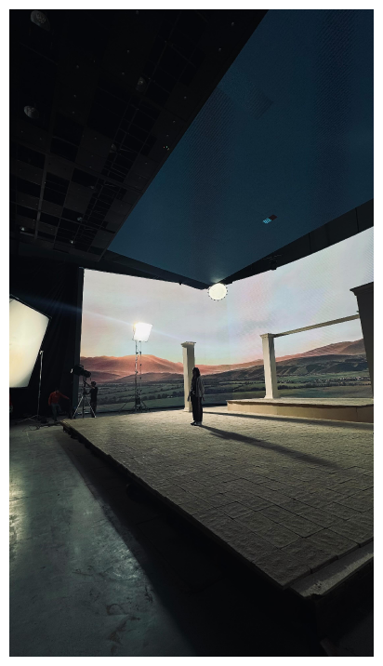
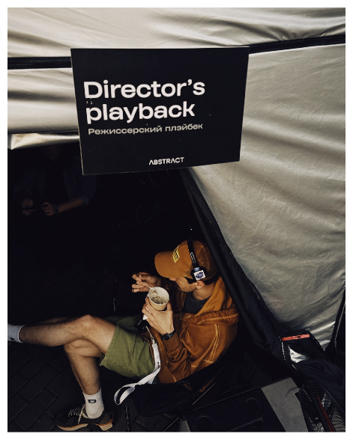
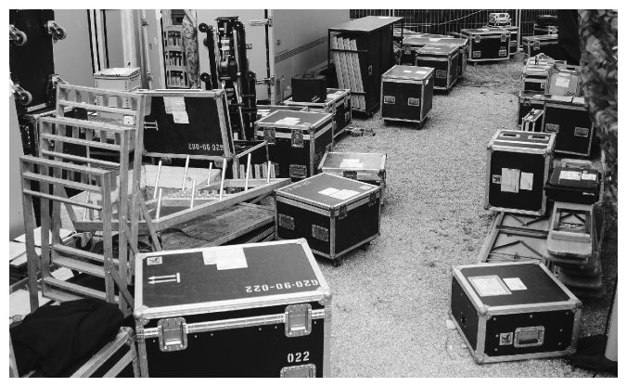
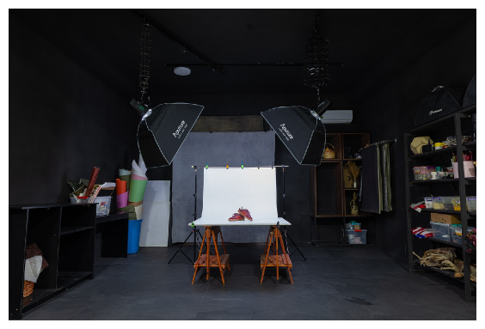
Notes:
Однако что бы мероприятие стало незабываемым, требуется пот и кровь, многих - организаторов, волонтеров, поставщиков, постановщиков и тд.

Slide 3
Planning an event can take 40 to 120 times more time than the event itself.
Notes:
It's important to recognize that planning an event is a significant time investment. In fact, it can take anywhere from 40 to 120 times more time than the actual event itself. This statistic highlights the complexity and effort involved in organizing successful events. Understanding this can help us allocate resources and time more effectively in our planning processes.

Slide 4

problems
event
makers
space
owners

Slide 5








problems
event makers
space owners
❌ Difficult to find suitable venues due to scattered sources.
❌ Low booking rates, especially for lesser-known spaces.
❌ Lack of transparent information on pricing, availability, and terms.
❌ Distrust toward new clients and lack of guarantees.
❌ Inconvenient communication with venue owners.
❌ Lost revenue due to last-minute cancellations or no-shows.
❌ High risk of fraud (e.g. venue cancellation at the last moment).
❌ No easy platform for promotion and exposure.
❌ No unified platform for reviews or verified listings.

Slide 6
joytop
From Empty Rooms to Iconic Moments
Join the Community of Visionaries

Slide 7
solution
A community-driven platform for booking venues for events, hackathons, conferences, photo shoots, art studios, coworking sessions, etc.
🎨 Focused on young creators, community leaders, and influencer-organizers.
🔍 Easy filters, transparent booking terms, peer reviews, and a sleek UI.
🏦 Escrow system to guarantee safety for both sides: funds are held until the event is confirmed.
💰 Monetization through commissions, premium listings, and promotional tools.
Notes:
Create a centralized platform for discovering and booking event spaces across Uzbekistan and beyond. Empower independent organizers and creatives with access to affordable, flexible, and verified venues. Digitize the rental process — search, inquiry, booking, payment, and feedback — through an intuitive UI/UX. Introduce trust mechanisms such as ratings, reviews, and an escrow-style payment model to reduce risks for both sides. Build a community-driven ecosystem of event creators and venue partners, supported by educational content and partnerships. Support niche events (hackathons, raves, art installations, workshops) that often don’t fit into conventional rental pipelines. We are not an event planning agency — we provide the infrastructure, not full-service planning. We do not own or manage the venues — we facilitate the connection between organizers and space providers. We are not a ticketing platform — we focus on space, not attendee management or ticket sales. We are not a social network, but we may support community features that enhance discovery and trust.

Slide 8
CHIEF EXECUTIVE OFFICER
SAIDJON MUKHITDINOV

Slide 9
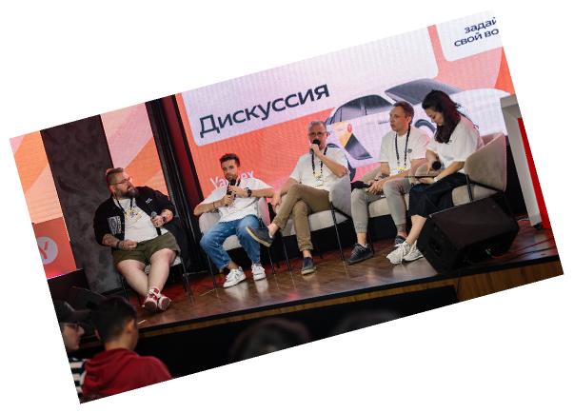
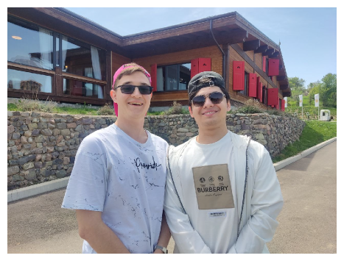
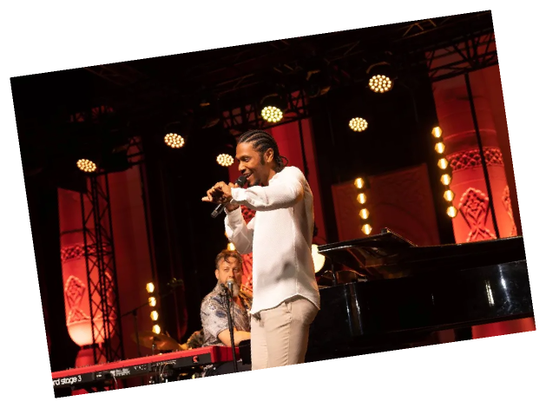
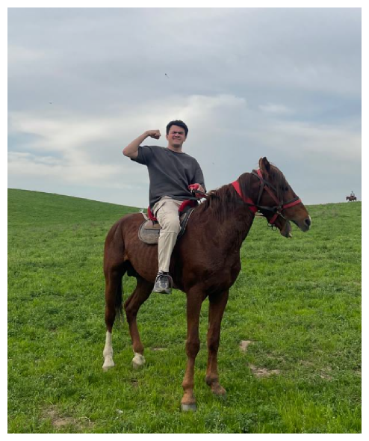
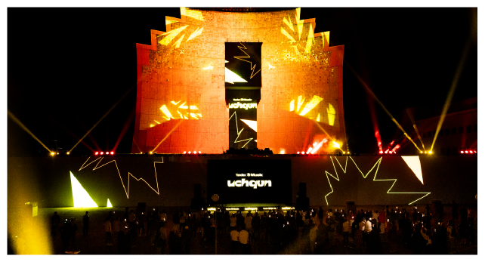
positioning
We’re building a platform that brings event organizers and venue owners together, offering a simple, secure service for booking and event planning.
By introducing innovative features, we aim to lead the market in safe event booking and create a space for creativity and collaboration.
joytop
From Empty Rooms to Iconic Moments
our mission
To make event planning in Uzbekistan simple, quick, and secure for all participants.
Streamline the preparation process and strengthen trust between event organizers and venue owners.
Promote a culture of events by offering a platform that enables users to create memorable and impactful experiences.
Bringing together culture and community.

Slide 10
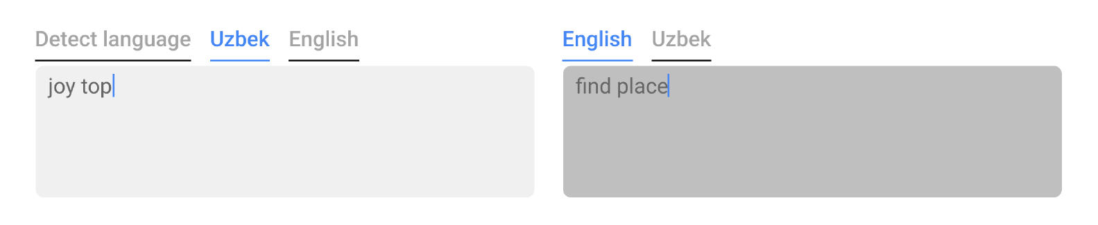
brand identity
Everything as simple as possible...
our values are Creativity, Transparency, Empowerment, Accessibility
4 words to describe joytop are young, energetic, community-focused, reliable

Slide 11

go-to-market strategy
How We Will Launch JoyTop and Drive Growth
Digital Marketing
Targeted advertising on social media (Instagram, TikTok, Facebook).
Content marketing: Create videos and articles to educate users.
Partnerships & Collaborations
Partner with event agencies, influencers, and key organizers.
Direct sales and promotions to attract early users.
Customer Acquisition
Launch pilot programs to test the platform with a select audience.
Implement referral programs and bonuses for early users.

Slide 12




long-term strategy
Brand Expansion and Recognition:
Strengthen brand presence through strategic marketing campaigns.
Build partnerships with major industry players and key influencers to enhance brand credibility and recognition.
Create a strong, recognizable brand that resonates with the target audience and establishes trust.
Growth Strategy:
Scale to new cities and regions.
Expand the partner network and attract new venue owners.
Organize proprietary events through the platform.
Product Development:
Introduce additional features such as analytics and personalized recommendations.
Continuously improve the user experience based on feedback and analytics.
Sustainability and Leadership:
Ensure high transaction security and enhance platform technologies to protect users.
Build and maintain an active user community.

Slide 13
CHIEF TECHNOLOGICAL OFFICER
ASADBEK FAZLIDDINOV

Slide 14
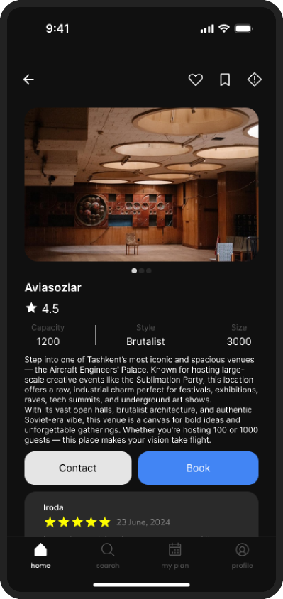
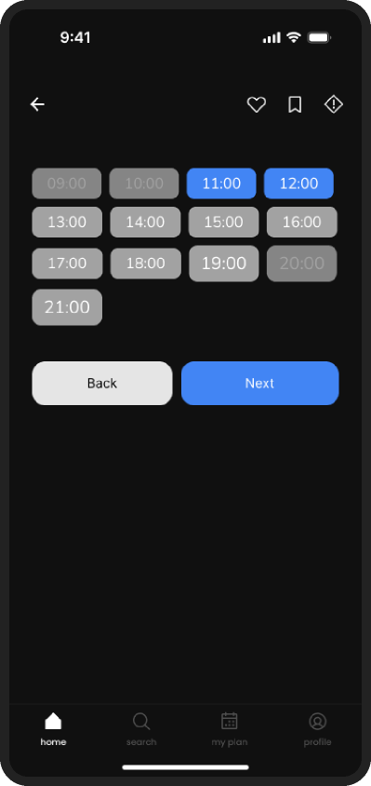
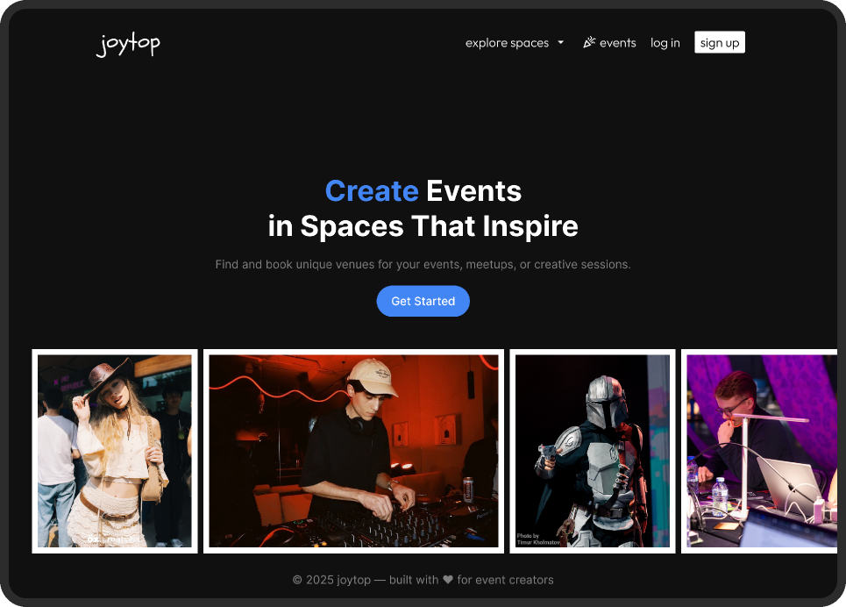

Slide 15
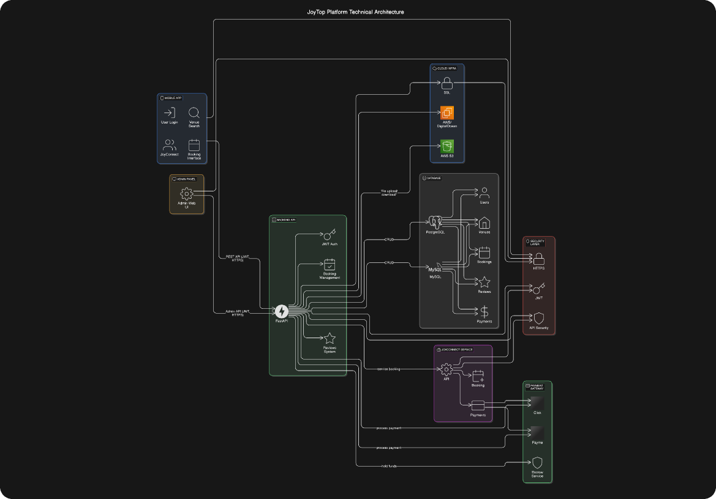
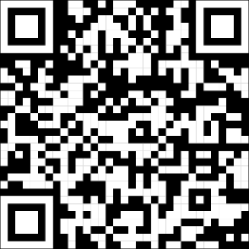




mvp
scan me
Python

Slide 16
CHIEF FINANCIAL OFFICER
SAMANDAR KAMBARALIEV

Slide 17



business model & financial projections
marketplace and transactional models
affiliate model
“We connect spaceowners with event organizers and take a commission per booking.”
“Spaces don’t run events — people do. We bring them to you.”
Event photography or videography teams
Sound, lighting, stage or furniture rentals
Staff, crew, catering or guest management services
Decor, setup or logistics solutions
10–15% commission on every successful transaction
Escrow-based — JoyTop holds funds until the event is confirmed
Encourage trust and increase platform engagement
pay-as-you-go model
“Organizers can pay for additional services as needed.”
Hidden analytical data for spaceowners
Boost in search list
Verification by creator
Notes:
Мы предоставляем широкий спектр услуг, из-за этого было решено использовать гибридный вариант бизнес модели

Slide 18

funding
seed funding &
angel investors
When you're in the early stages (MVP), need initial funding to test the market, or require guidance to refine your business model.
Flexible terms ideal for early-stage startups.
Mentorship and industry connections.
Smaller investments to help get your business off the ground.
venture capital
When product-market fit is confirmed, you have traction with users, and you need funds to scale and expand to new regions.
Large investments to accelerate growth.
Expert guidance and a strong network for rapid expansion.
Focus on high growth with quick returns expected.
accelerators & Incubators
crowdfunding
grants government & private

Slide 19
costs
marketing funding | $15k total
Influencer Seeding & UGC | $3,000
Paid Social (SMM Performance) | $3,500
Event Activation (IRL Marketing) | $3,000
Content and Production | $1,500
Referral & Loyalty Systems | $1,000
Referral & Loyalty Systems | $1,000
Salary for Team | $2,000
operational funding | $5k total
Payment Services | $500
Legal Expenses | $500
Infrastructure and Office | $1,000
Customer Service | $1,000
Referral & Loyalty Systems | $1,000
Salary for Team | $1,000
technical funding | $13k total
Platform Development | $3,500
Hosting & Infrastructure | $2,500
Development Tools & Licenses | $1,000
Contingency | $1,000
Salary for Team | $5,000

Slide 20
risks & mitigation
Insufficient Cash Flow / Capital Shortages
Secure early-stage funding and track cash flow closely
High Operating Expenses (Burn Rate)
Optimizing operational costs and scaling at a manageable pace
Delayed or Insufficient Revenue from Bookings
Offer early booking incentives and use automated invoicing to ensure timely payments
Overdependence on a single revenue stream
Diversify income by adding premium services and forming strategic partnerships
Poor financial tracking & reporting
Use accounting software tracking and set monthly KPI reviews
Lack of clear profitability path
Set clear profitability goals and manage costs while focusing on high-return investments
Uncertainty in market demand
Regularly validate market demand through user feedback and small-scale test campaigns

Slide 21
CHIEF MARKETING OFFICER
TIMUR URUNBAEV

Slide 22

target audience
Psychographics: creative, value community & uniqueness
1. Independent Event Creators
Motivation: Build their own community, create memorable events, gain visibility
2. Professional Event Planners & Agencies
Motivation: Reduce operational risks and save time while pleasing high-end clients
3. Small Business Owners & Influencers
Motivation: Grow brand presence, experiment with in-person formats
4. Venue Owners (Secondary Audience)
Motivation: Monetize underused space, join creative ecosystem, build reputation
keywords: meeting room, photoshooting, studios, workshop space, coworking space, concert spaces, art exhibitions, seminar room, board room, awards ceremony, training room, day office, podcast recording, music studio, conference hotel, business center, office space, corporate event space, fashion event, product showcase, rooftop party...
Notes:
1. Independent Event Creators Who: Young organizers (18–35), creatives, students, community builders Needs: Affordable, flexible venues for hackathons, meetups, exhibitions, parties Pain Points: Lack of centralized platform, high upfront costs, lack of transparency Motivation: Build their own community, create memorable events, gain visibility 2. Professional Event Planners & Agencies Who: Corporate event managers, wedding planners, production teams Needs: Verified venues with scalable capacity, clear logistics, fast booking Pain Points: Manual venue scouting, non-standardized pricing, legal/contractual friction Motivation: Reduce operational risks and save time while pleasing high-end clients 3. Small Business Owners & Influencers Who: Studio owners, micro-entrepreneurs, local brands, content creators Needs: Short-term space for launches, pop-ups, content shoots Pain Points: High rental deposits, inconsistent communication with landlords Motivation: Grow brand presence, experiment with in-person formats 4. Venue Owners (Secondary Audience) Who: Owners of studios, cafes, industrial halls, cultural centers, campuses Needs: Consistent bookings, exposure to a younger audience, minimal friction Pain Points: Low visibility, high seasonality, unreliable tenants Motivation: Monetize underused space, join creative ecosystem, build reputation

Slide 23
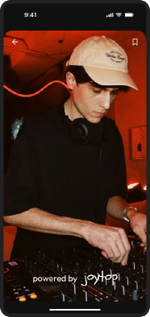
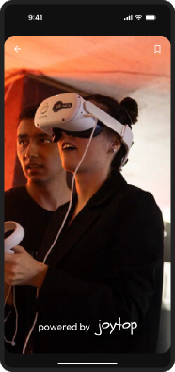
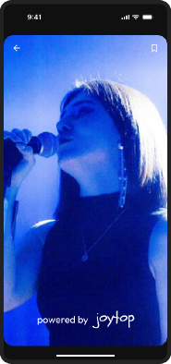
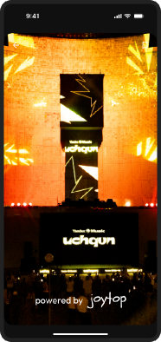
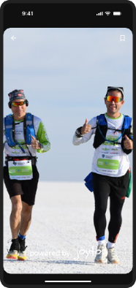
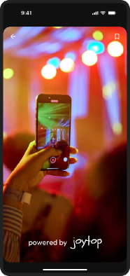
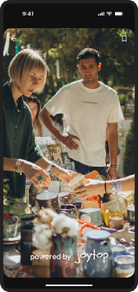

marketing strategy
89% internet penetration (32.7 million users)
92.2% mobile connections (33.9 million)
31.7% active social media users (11.7 million)
Median age: 27 years
powered by
joytop
https://datareportal.com/reports/digital-2025-uzbekistan
Notes:
Psychographics: creative, value community & uniqueness 139documentarycenter moctab nukus.89 oz.tashkent sahna standup kettu acdfuz ayda tuda itv we project media

Slide 24
marketing strategy & key metrics
✅ Goal (6 month)
Marketing Channels
spaces
MAU
bookings
Influencer Marketing & UGC
Action: Collaborate with micro-influencers (TikTok, Instagram, Telegram)
Paid Social Ads (SMM)
Action: Targeted ads on Instagram, TikTok, Telegram
Event Sponsorships & Activations
Action: Sponsor local events (“Powered by JoyTop”)
Referral Program
Action: Incentivize user growth through referral bonuses
Content Creation (Photography, Promo Videos)
Action: Showcase top venues and event success stories
Branding & Community Building
Action: Create promotional materials and build presence on Telegram
100+
1500+
3000+
Key Metrics to Measure Success
User Acquisition:
Goal: 1,000–1,500 active users
User Engagement:
Goal: Increase repeat bookings and active usage
Retention:
Goal: 30-day retention > 40%

Slide 26
cast
Chief Executive Officer
Saidjon Mukhitdinov, 210814
Chief Technology Officer
Asadbek Fazliddinov, 210086
Chief Financial Officer
Samandar Kambaraliev, 210034
Chief Marketing Officer
Timur Urunbaev, 210080
crew
Executive Researcher & Brainstorming Partner
ChatGPT
Global Intelligence Network
Google
Lead Interface Architect
Figma
Visual Directors
Timur Urunbaev, ChatGPT
soundtracks
Morning alarm
Keyboard typing
“Can we meet in 5?”
“Bro, let’s submit before midnight!”

